Slide 1
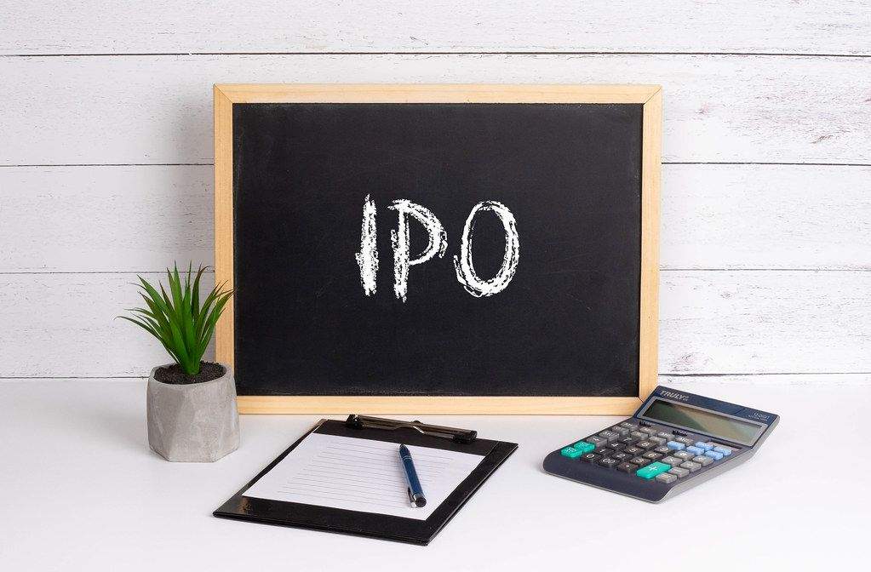

IPO Report
Quadrant Future Tek Ltd
5 Jan 2025
Rating: Avoid
Reason: high valuations compared to listed peers. Risky business as company betting too much on growth from Indian Railways Kavach project

Slide 2

About the Issue
Issue Date | 7 Jan to 9 Jan 2025
Price Band | ₹275 to ₹290 per share
BidLot | 50 shares
Issue Size | ₹290 cr
No. of Shares (Post Issue) | 4.0 cr
Offer for Sale | 0% (this goes to promoters pocket)
Fresh issue | 100% (this goes to company accounts)
Objects of the issue | Rs 149 crore for working capital requirement of Specialty Cable segment which is expanding in EVs and Solar markets; Rs24 crore will be allocated for capex in Electronic Interlocking System development and Rs23crore for repayment of some working capital loans
Post-Issue Implied Market Cap | ~₹1,160 cr
Listing at | BSE, NSE

Slide 3
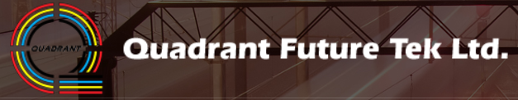
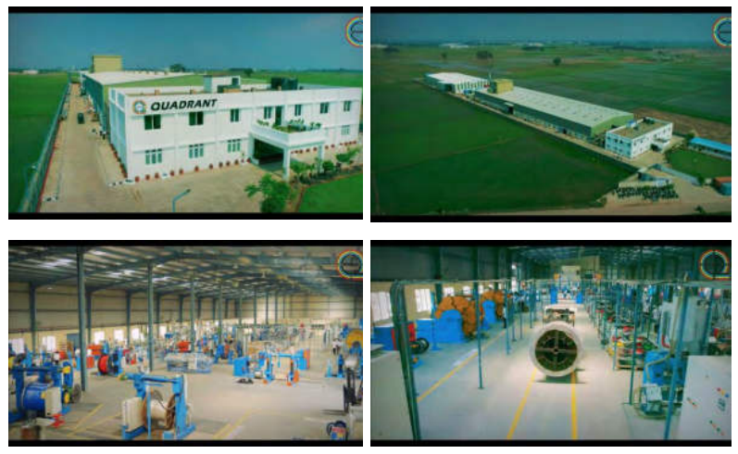
Quadrant FutureTEK offers Products & solutions in the following four verticals: Speciality Cables; Cable Assemblies & Interconnect Solutions; electrical/Electronic Systems & Displays and End to End Solutions in Train Control & Signalling Solutions. Most of the manufacturing is based out at Mohali in Punjab

Slide 4
Overview of Business Divisions
Revenue split over last 3 years
Specialty Cables Division - offers Speciality Cables for the industrial usage and other applications where fire and safety, light weight and long term performance are of utmost importance
Company has a wide product portfolio which includes railways rolling stock cables, naval defence, marine cables, solar PV cables, automotive cables, and connectors & junction boxes. They also provide provide end to end solutions for electrical connectors and wiring harness with the complex arrangement of various wires and cables as per the demand of the client
They have an installed capacity of 1,887.60 metric tonnes. Current Capacity utilization is around 57%
Train Control & Signalling Division – Company has dedicated Railway Signalling & Embedded System Design centre for the development of Train Control Products & Solutions and is working towards development of Train Collision Avoidance System and Electronic Interlocking System under KAVACH project
After successful testing in 2023, this company has been awarded technical clearance for deployment of its KAVACH system and order has been received from Indian Railway for installation of the same at 5 railway stations, 10 trains / locomotives and 5 units of Remote Interface Unit besides the track on a stretch of 43.6 km at “Moula-Ali (Excluding) - Raghunathapalli section of South Central Railway - Reach 2” covering 5 stations and 10 train sets. The said order is for an aggregate value of ₹ 16.86 crore
Company has also received purchase order on December 12, 2024 from CLW for the supply, installation, testing, and commissioning of On-board Kavach equipment in 1,200 locomotives for an aggregate value of ₹ 978.60 crore
They had an installed capacity of 4,492 Station TCAS, 2,264 Locomotive TCAS and 3,744 Remote Interface Unit
The company's infrastructure facility for manufacturing, testing, researching, and developing specialty cables is at Distt Mohali in Punjab. And their Railway Signalling & Embedded System Design centre for Train Control & Signalling Division is based at Bengaluru, Karnataka and Hyderabad, Telangana.

Slide 5
SWOT Analysis
Strengths
Operating in niche specialty cables market which needs high expertise
Qualified 4th supplier out of total 5 shortlisted firms for implementation of KAVACH project by Indian Railways
Weakness
Indian Railways contribute 41% of revenue
And another 34% revenue comes from related parties namely 4 promoter groups
Opportunity
Expanding beyond promoter group and adding more business in defence sectors
Expanding in industries like EV and solar, which requires more specialised power cables which company can serve
Additional opportunities in Electronic Interlocking Systems for Indian Railways
Entered into an exclusive MoU with RailTel for delivering the specific targeted opportunities related to KAVACH in Indian Railways and other Countries Railways
Threats
No long standing customer relationships. Most of the work in project based. So company has to continuously apply for tenders and win projects
Small player is cables industry which is dominated by international firms and even big Indian firms like Polycab, HBL Power Systems

Slide 6
Key Financial Highlights
For six months Sep ‘24
Profit before tax, before exceptional items from wires and cables division was ₹ 7.14 crore, which is about 11.44% of the total income from Speciality Cables division
Further, the Company has incurred loss before tax from Train Control & Signalling division which aggregated to ₹ (19.64) crore.
Company had capitalised the expenses towards development of intangible asset for Train Collision Avoidance System on October 18, 2023, the expenses incurred towards the said division post such capitalisation are charged to profit and loss account, without any corresponding income being generated at present.
So Speciality cables division is in profits with EBITDA margin at 19.5%
Debt has increased in 2024, however portion of that will be reduced with repayments from the funds raised through IPO. Said that high debt will impact future profits and RoE
P&L Key Stats | FY 22 | FY 23 | FY 24 | 6M Sep 24
Revenue | 104.25 | 152.8 | 151.75 | 65.13
EBITDA | 9.5 | 26.54 | 36.66 | 0.81
% of sales | 9.1% | 17.4% | 24.2% | 1.2%
Profit After Tax | 1.89 | 13.81 | 14.69 | -12
% of sales | 1.8% | 9.0% | 9.7% | -18.4%
RoCE (%) | 8.4% | 27.2% | 26.1% | -37.5%
Balance Sheet Key Stats
Net Worth | 15.61 | 29.42 | 44.11 | 34.18
Reserves and Surplus | 5.61 | 19.42 | 34.11 | 4.18
Total Borrowing | 80.68 | 74 | 81.61 | 98.01
Debt to Equity Ratio (in times) | 5.2 | 2.5 | 1.9 | 3.1

Slide 7
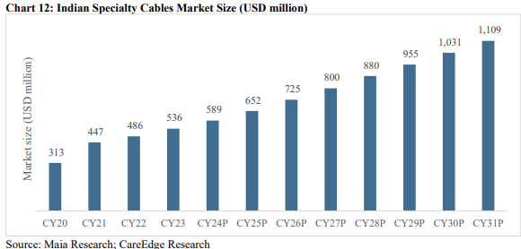
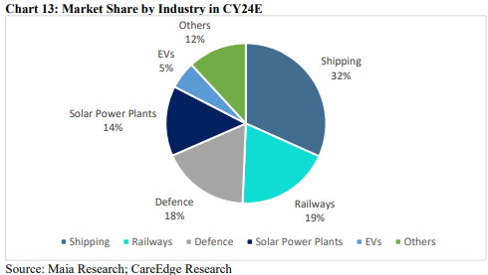
Specialty Cables Market
This market is forecasted to register a CAGR of 9.8%. This is attributed to infrastructural developments in the country. Accordingly, the projected growth drivers include renewable power generation, expansion and revamping of transmission & distribution infrastructure, expansion & improvement in the railway network, and increasing investments in metro projects.
Railways is one of the key consumer segments in the specialty cable industry. Wherein, specialty cables are used in signalling and control system, power supply and communication system. Among the rail transit cables, specialty cables with DC tractions, flame-retardant, fire-resistance, green environment friendly and self-temperature control cables are used in railway construction

Slide 8
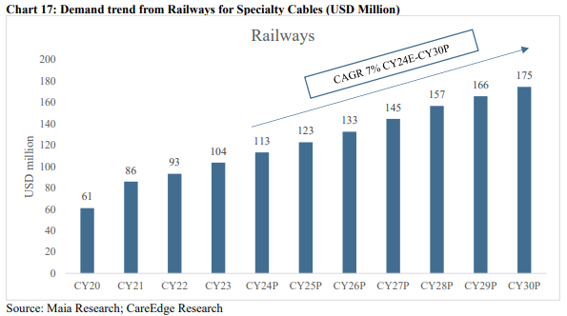
Specialty Cables - Demand from Railways
The contribution from the railway segment in the specialty cable market was valued at USD 104 million in CY23 which is expected to reach USD 113 million registering a 9% y-o-y growth in CY24E. For the forecast period CY24E-CY30, the segment contribution is anticipated to grow at 7% CAGR. The Government of India has identified railways as a key focus area to boost GDP and make India more export competitive by reducing freight costs. This augurs well for the specialty cables industry overall.
Number of factors which are driving demand for Specialty cables by Indian Railway are:
Indian Railways is rapidly progressing to accomplish Mission 100 Percent Electrification. Also it plans to source 1,000 MW of solar power and 200 MW of wind power across zonal railway and production units
Automatic Block Signalling is a cost-effective solution to increase the line capacity to run more trains on the existing High-Density Routes of Indian Railways
Electronic Interlocking is being adopted on a large scale to derive benefits of digital technologies in train operation and to enhance safety

Slide 9
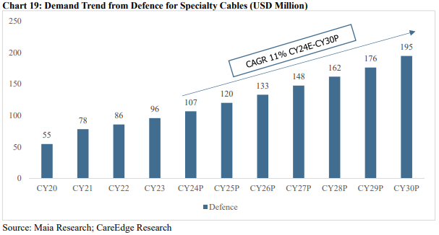
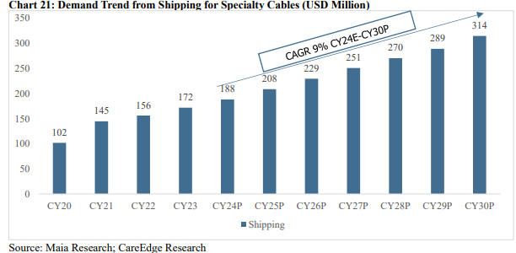
Specialty Cables - Demand from Defense and Shipping
India’s defence budget for capital outlay has increased from Rs1.1 lakh crore in 2020 to Rs1.6 lakh crore in 2024. To provide impetus to self-reliance in defence manufacturing, the government is striving to develop a robust eco-system and provide supportive policies.
India's defence exports have reached an all-time high, surging from ₹ 686 crores in FY14 to nearly ₹ 21,083 crores in FY24.
The increasing government investment has boosted the defence industrial manufacturing ecosystem in the country and generated tremendous employment opportunities, which supports the specialty cables market growth in India.
India has one of the largest coastlines of about 7,517 km, 12 major ports, and 205 notified minor & intermediate ports. India’s competitiveness in global trade is expected to increase with initiatives such as Make in India, Atmanirbhar Bharat, PLI Schemes for key sectors, etc. The government is focusing on increasing the domestic manufacturing of shipping containers to eliminate the dependence on imported containers.
The shipbuilding industry growth is likely to foster the growth of its sub-sectors, including the specialty cables industry.

Slide 10
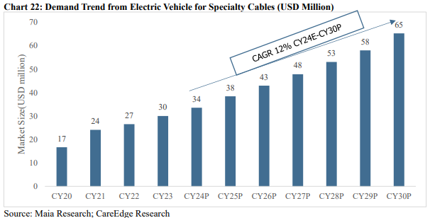
Specialty Cables - Demand from EV and Solar
Electric vehicles use a large amount of electronic equipment. Specialty power cables play an important role in the safety of new energy vehicles. For instance, high-quality specialty power cables can ensure that the electrical system can work properly and ensure a low failure rate, thereby reducing the risk of accidents such as fires and explosions.
Measures taken by the government to accelerate EV transition, development of local manufacturing of batteries, and increasing affordability of the vehicles, augur well for the sector, which is anticipated to see long-term growth in the future
Cables are necessary elements for transmitting solar power. Such (specialized) cables are designed to connect solar panels to the electrical grid, enabling the widespread adoption of solar power. They are manufactured to withstand extreme weather conditions, resist UV rays, and handle high electrical loads, making them an essential component in the development of solar power systems.
The specialty cable market growth is attributable to the positive outlook for the solar power segment, further accredited to government support and growing environmental consciousness.

Slide 11
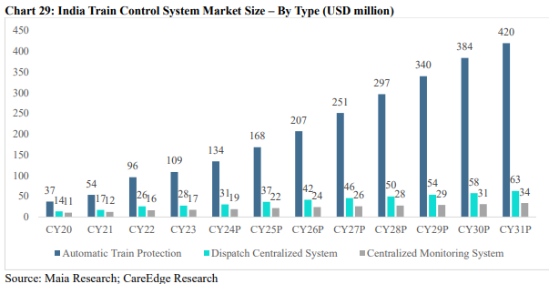
Indian Train Control System Industry
The growth of the train control system industry in India is influenced by several key growth drivers that promote modernization, efficiency, and safety in the Indian Railways network.
Automatic Train Protection holds the biggest share of this market. And under this category Indian Railways “Kavach” project comes, which is basically indigenously built Train Collision Avoidance System.
The Indian train control system industry plays a crucial role in ensuring the smooth and secure operation of trains across the Indian Railways network. For which, Indian Railways is developing and creating technology in areas such as signalling and telecommunication with 15,000 kms being converted into automatic signalling and 37,000 kms to be fitted with 'Kavach’.
High speed rail corridors under development by Indian Railways is also boosting the requirement for more expenditure on safety and hence driving the growth of Automative Train Protection solutions
In terms of freight carriers, the Indian Railways envisages increasing the modal share of the railways in freight to 45% by CY30. To meet such growing demand efficiently, the train control system is expected to provide various services like smooth passenger and freight operation management, safety monitoring, and railway communication and network to meet the changing needs of passengers while reducing commuting time and enhancing travel experience.

Slide 12
Benchmarking and my take
 | APAR Industries | Polycab | HBL Power | Quadrant Future
Market Cap | ₹ 43,987 Cr | ₹ 1,08,422 Cr. | ₹ 17,311 Cr. | ~₹1,160 cr
Revenue | ₹ 17,119 Cr. | ₹ 20,129 Cr. | ₹ 2,250 Cr. | ₹ 151 Cr.
EBITDA margin | 10.00% | 15.00% | 19.76% | 24.20%
PAT Margin | 4.99% | 9.94% | 12.50% | 9.70%
RoCE% | 34.87% | 30.04% | 31.75% | 26.10%
Debt to Equity | 0.13 | 0.02 | 0.76 | 3.10
P/E ratio | 51.8 | 60.4 | 50 | 59
Quadrant Future is coming with upper price band of Rs 290 per share and that means a PE of ~59 (at its FY24 EPS of 4.9), which seems expensive when compared with listed peers
Higher debt to equity ratio is a concern for this firm with currently small scale. Company is betting too much on revenue growth anticipated from Kavach project which could materialize well or could fail as well
My take is to avoid the IPO as the promoter are not leaving much for the investors for listing gains. However we could revisit this stock for long term investment after its yearly results to check what revenue finally the company generates from Kavach project and how the order book is built for coming years

Slide 13

Thank you Follow Me on Social Media

Slide 14
Disclaimer
I, Vishal Trehan, is a SEBI Registered Research Analyst having registration number – INH000016816.
No penalties / directions have been issued by SEBI under the SEBI Act or Regulations made there under against the Company or its Directors.
Risks: Trading and investment in securities are subject to market risks. There are no assurances or guarantees that the objectives of any of trading / investment in securities will be achieved. The trades/ investments referred to herein may not be suitable to all categories of traders/investors. The value of securities referred to herein may be adversely affected by the performance or otherwise of the respective issuer companies, changes in the market conditions, micro and macro factors and forces affecting capital markets like interest rate risk, credit risk, liquidity risk and reinvestment risk. Derivative products may also be affected by various risks including but not limited to counter party risk, market risk, valuation risk, liquidity risk and other risks. Besides the price of the underlying asset, volatility, tenor and interest rates may affect the pricing of derivatives.
Registration granted by SEBI, and certification from NISM in no way guarantee performance of the Research Analyst or provide any assurance of returns to investors.
There are no actual or potential conflicts of interest arising from any connection to or association with any issuer of products/ securities, including any material information or facts that might compromise its objectivity or independence in the carrying on of Research Analyst services. Such conflict of interest shall be disclosed to the client as and when they arise

Slide 15
Disclosures
The Research Analyst or its employee have not:
does not trade in securities which are subject matter of recommendation.
received any compensation from the company which is subject matter of recommendation/research;
managed or co-managed the public offering of any company;
received any compensation for investment banking or merchant banking or brokerage services from the subject company;
received any compensation for products or services from the subject company;
received any compensation or other benefits from the Subject Company or 3rd party in connection
served as an officer, director or employee of the subject company;
been engaged in market making activity of the subject company.
Also, the subject company was not a client of the Research Analyst during twelve months preceding the date of report.

